Slide 1
Study Skills
Developing Effective Strategies for Success
Notes:
This presentation focuses on the significance of study skills in enhancing pupil performance. We’ll explore essential skills and strategies to ensure students are well-prepared for academic challenges.

Slide 2
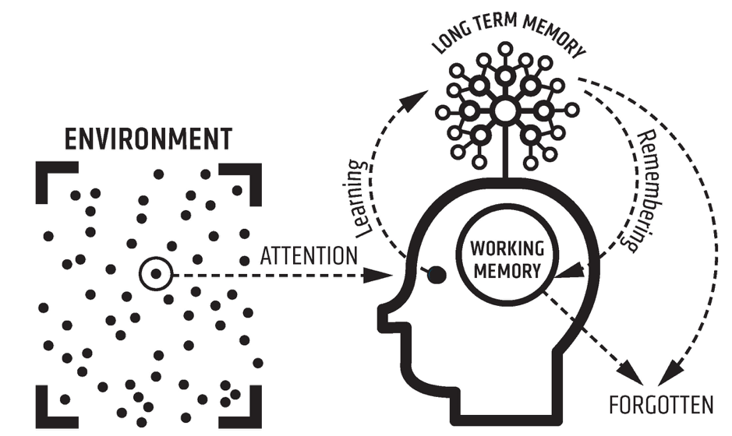
How Do We Learn?
Notes:
The Science: How do we learn/how does the brain work?

Slide 3
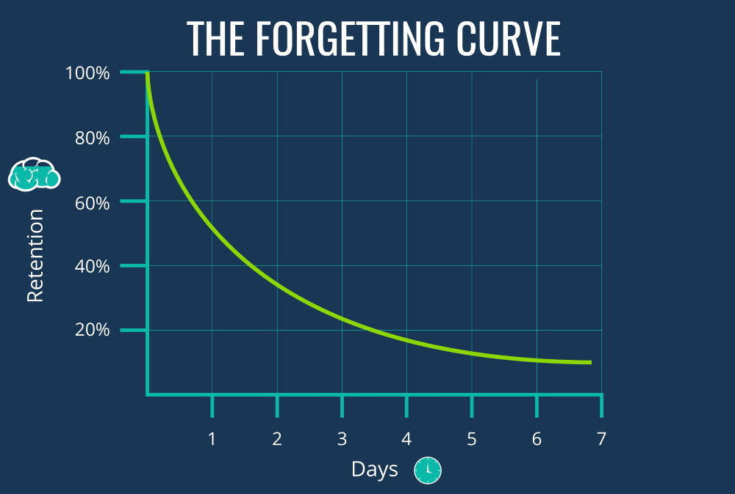
Notes:
The Science: The Forgetting Curve
a model by Hermann Ebbinghaus that describes the rapid decline of memory retention over time when there's no attempt to retain it. It shows that most information is forgotten quickly after learning, but this decay can be slowed by spaced repetition—reviewing information at increasing intervals—which strengthens memory. To fight the forgetting curve, learners should actively review material, practice recall through quizzes, make information meaningful, and use spaced learning techniques

Slide 4

Working Memory
https://www.youtube.com/watch?v=_nWMP68DqHE
Notes:
The Science: How do we learn/how does the brain work?

Slide 5
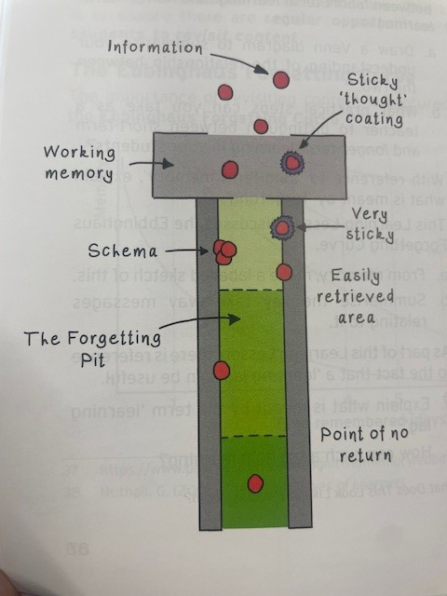
Making Learning
‘Sticky’
‘If you don’t use it, you lose it’
Notes:
The Science: Making Learning ‘Sticky’

Slide 6

Planning and Resources
Notes:
Effective study skills are crucial for academic success. They enable us to manage time efficiently, improve comprehension, and retain information better. Developing these skills lays the foundation for lifelong learning, fostering independent learners who can adapt to various educational environments.

Slide 7
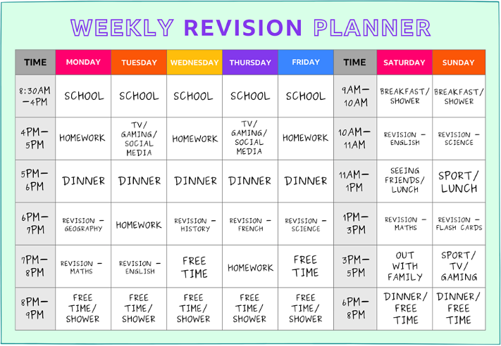
Planning and Goal Setting
Notes:
Planning time
Alarms on phone for study and homework that are labeled by Subject
General week timetables incld. jobs, hobbies (exemplars that can be printed/digitised)

Slide 8

Achieve – type in ‘Let’s achieve’ to google
School code – 9peTwCyh

Slide 9
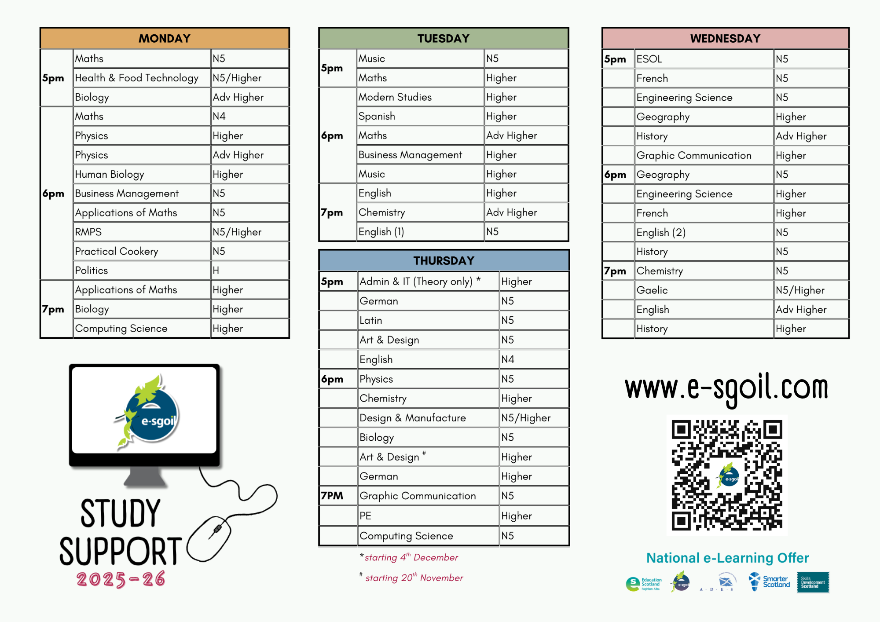

Slide 10
BBC Bitesize
Click ‘Scotland’
Click ‘National 4’, ‘National 5’ or ‘Higher’
Click the subject you want to study

Slide 11
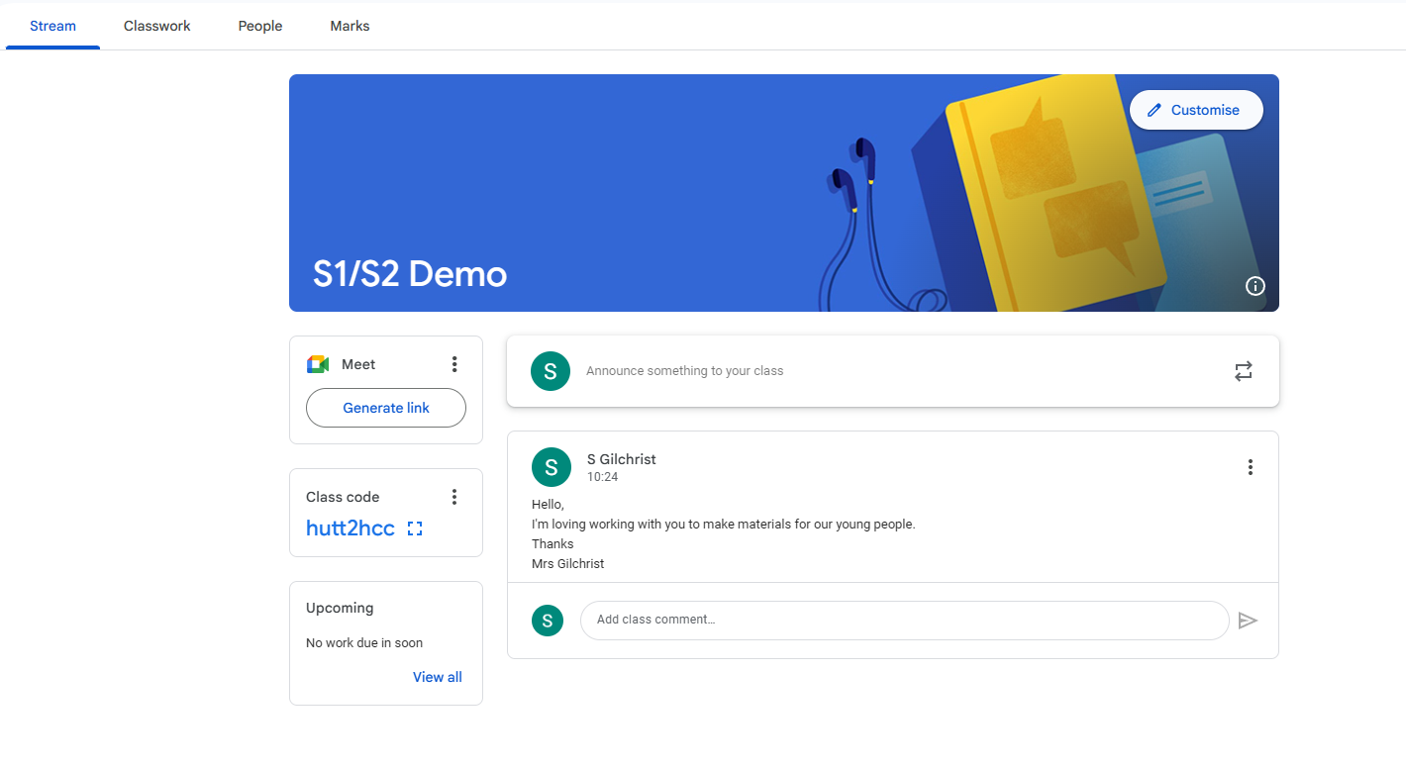
Google Classroom

Slide 12
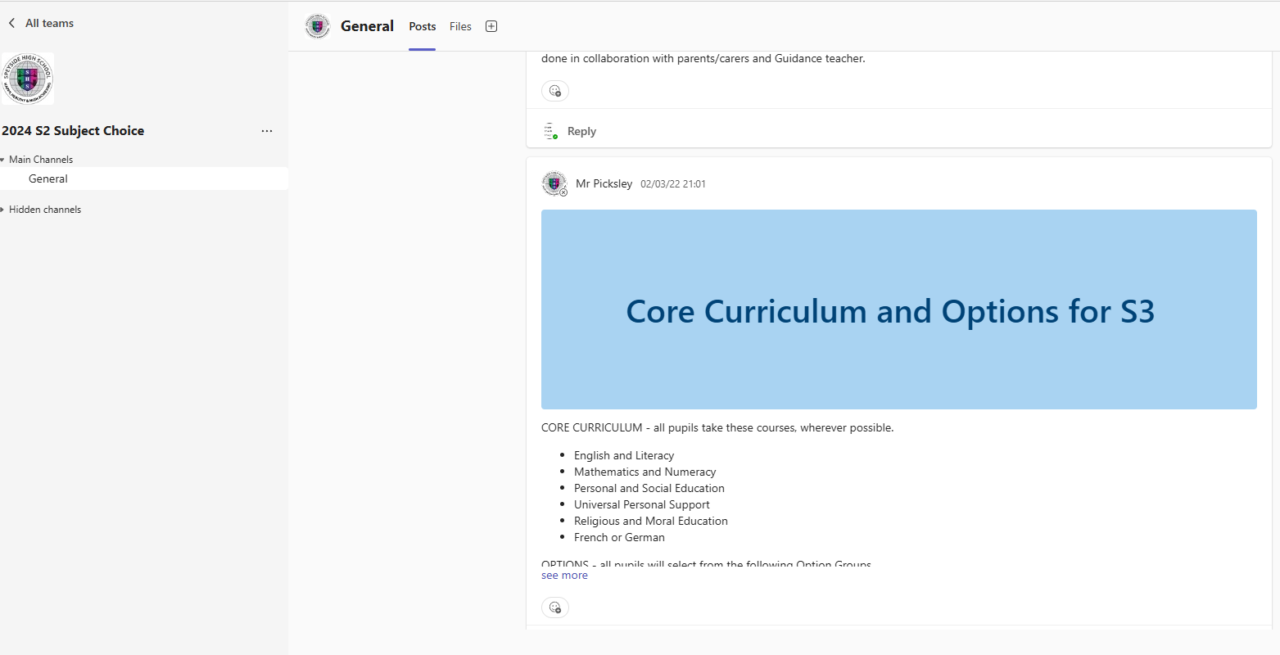
Microsoft Teams

Slide 13

Study Club Tuesday and Wednesday
Subject specific help
Ask questions
Get tailored support

Slide 14
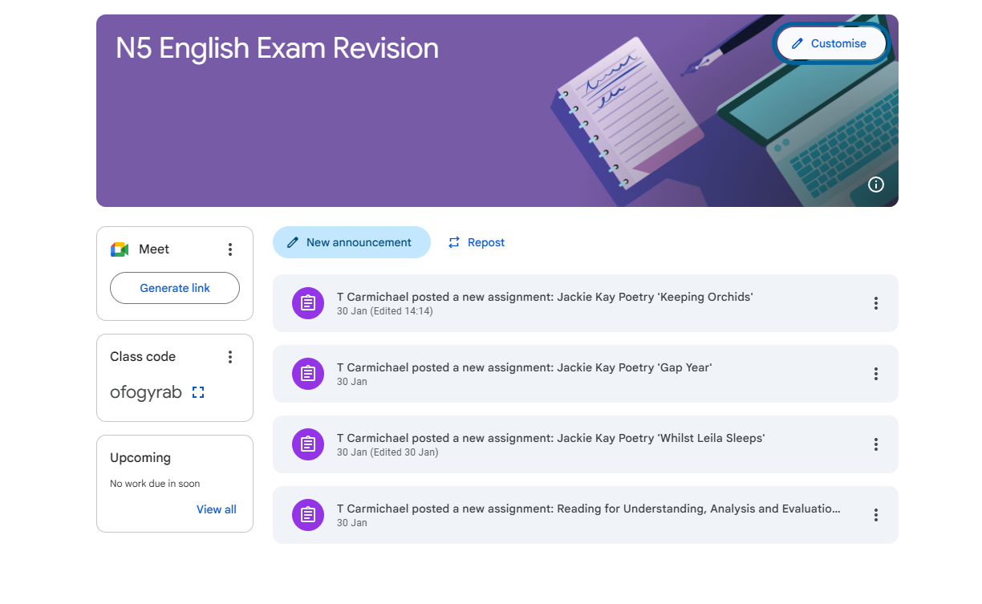
National 5 English Exam Revision Google Classroom

Slide 15
Strategies
Tools &
Techniques!

Slide 16
Note-Taking and Study Techniques
Mind Maps (familiar)
Dual Coding (new)
Mnemonics (familiar?)
Flashcards (In Room 9 and Library)
Repetition
Notes:
Only introduce 2 new ones at S1/2? And introduce others at S3 and more at S4-6?

Slide 17
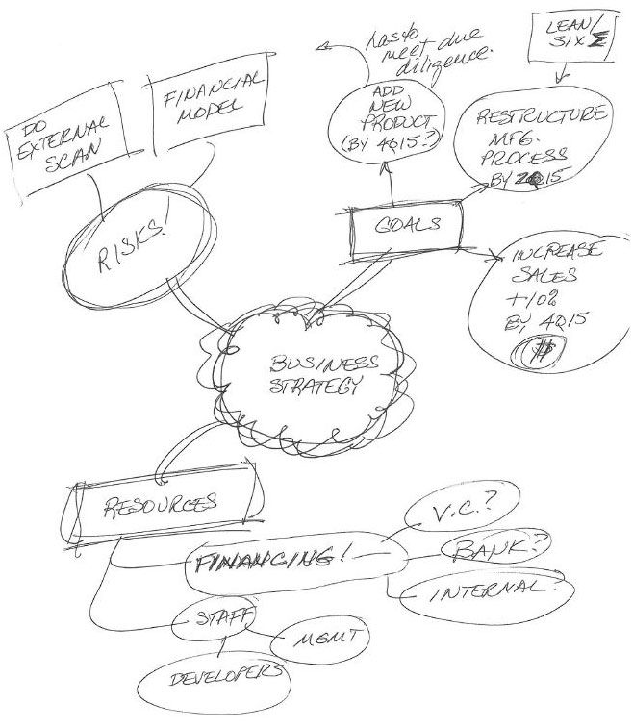
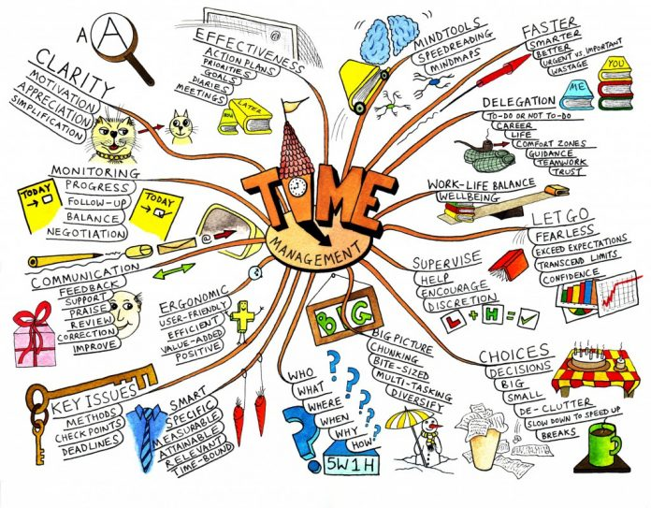
Mind Maps

Slide 18
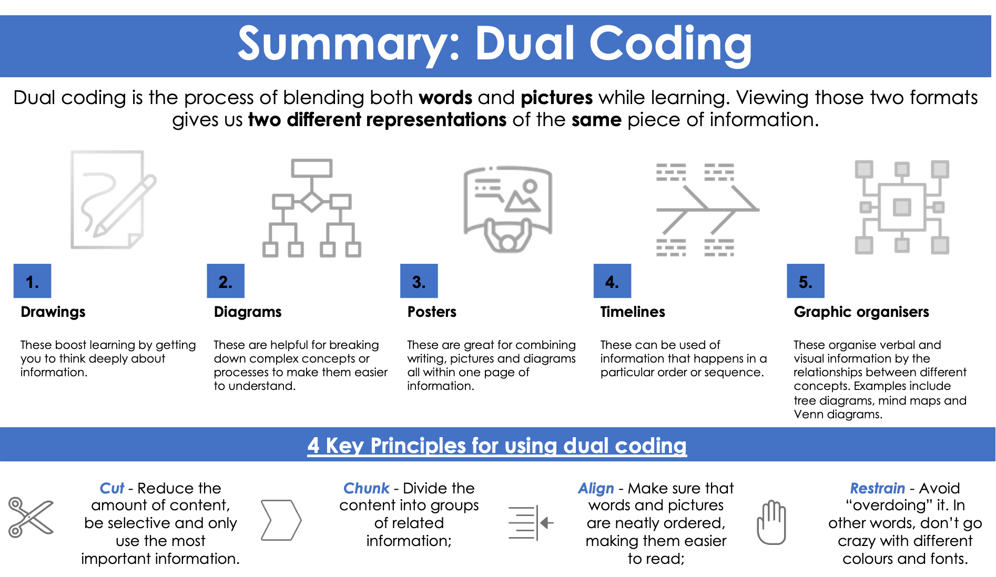
Dual Coding
Dual Coding is the process of blending both words and pictures while learning. Viewing those two formats gives us two different representations of the same piece of information.

Slide 19
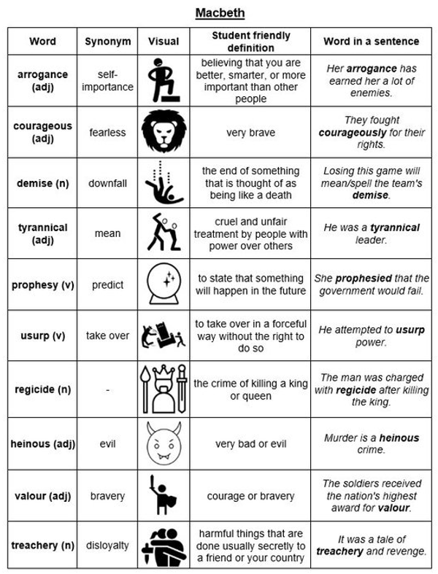

Slide 20
Some Study Strategies
Pomodoro timers – 25 minute slots, 5 minute breaks
Spaced Intervals Practice
Recording Summaries
Signing up to the e-Sgoil webinars for subjects
Qualifications Scotland past papers https://www.sqa.org.uk/pastpapers/findpastpaper.htm
Notes:
For S3- Senior Phase?

Slide 21


Slide 22
Achieve – type in ‘Let’s achieve’ to google
School code – 9peTwCyh

Slide 24
Thank you!
Do you have any questions?
+00 000 000 000

